Slide 1

Biostatistics DAY 3: Error Bars
Justin Whalley

Slide 2
Utilizing an iPSC derived macrophage model to look at Ankylosing Spondylitis relevant enhancers: TNFRSF1A
Work from Dr Julie Osgood

Slide 3
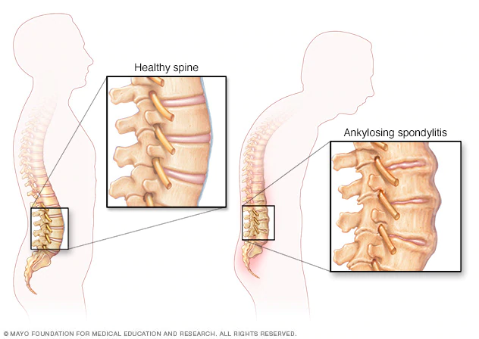
Ankylosing Spondylitis
Chronic inflammatory disorder
inflammation and osteoproliferation of the spine and sacroiliac joints
Age of onset 20-30
Affects men 2x more
Prevalence is 0.1-2%
Affects ~63000 in UK
Complex genetic disorder
Parent-child recurrence risk 7.9%
Heritability of 90%
HLA-B27
Multiple GWAS
48 loci currently associated
Treatments are often ineffective
Brown et al. Arthritis Rheum . 1997
Ellinghaus et al. Nat Genet. 2016
Linda et al. Rheumatology. 2014
Palla et al. Clin Exp Rheumatol. 2012
Pedersen et al. Scand J Rheumatol. 2008
Raychaudhuri & Deodhar . J Autoimmun. 2014
Notes:
Brown et al. Arthritis Rheum . 1997
Ellinghaus et al. Nat Genet. 2016
Linda et al. Rheumatology. 2014
Palla et al. Clin Exp Rheumatol. 2012
Pedersen et al. Scand J Rheumatol. 2008
Raychaudhuri & Deodhar . J Autoimmun. 2014

Slide 4
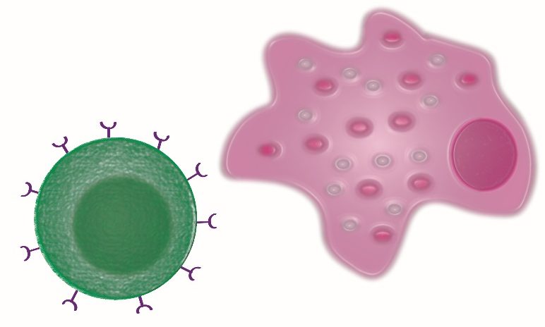

iPSC Derived Macrophages as a Model
Many immune cell types are implicated in disease
Unsure which is the most relevant
Strong evidence for monocytes/macrophages and T cells
Primary immune cells difficult to culture and edit
Limon-Camacho et al. J Rheumatol 2012
Wright et al. Ann Rheum Dis 2009
Zambrano-Zaragoza et al. Int J Inflam.2013
Notes:
Stem cells could be differentiated into other cell types down the line
Monocytes are the precursors for macrophages and dendritic cells, which are all involved in antigen presentation. Studies have found that monocytes in arthritis patients exhibit an upregulation of genes involved in essential inflammation pathways (101–103). One study used label-free quantitative expression profiling to examine protein expression (103). They noted upregulation in AS monocytes in proteins involved in leukocyte recruitment, and important signalling pathways such as, VEGF, JAK/STAT, and toll-like receptor (TLR). Moreover, there was shown to be an upregulation of genes in the ubiquitin proteasome pathway (UPP) in AS monocytes (103). This pathway is involved in the formation of peptides to be presented by HLA ClassI proteins, like HLA-B27.
One theory of AS pathogenesis, known as the arthritogenic
peptide hypothesis, relies on the involvement of CD8þT cells
[99, 100]. This hypothesis suggests that the self-peptides displayed
by HLA-B27 bear a resemblance to peptides produced by
foreign microbes and become the target of autoreactive CD8þT
cells. These cells then initiate an immune response and inflammation
ensues.
Moreover, it was found that CD4þT cells express
KIR3DL2, which is a receptor that recognizes homodimers
of HLA-B27 but does not recognize heterodimers of HLA-B27
The binding of KIR3DL2 to HLA-B27 homodimers could
trigger an immune response and lead to inflammation, and it is
also suggested that binding triggers Th17 responses
Monocytes in spondyloarthritis
patients exhibit an upregulation of genes involved in
essential inflammation pathways.

Slide 5
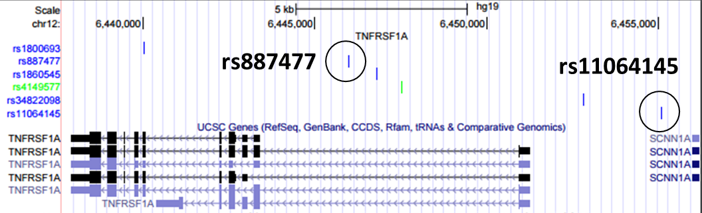
TNFRSF1A
Main TNF receptor
Fine mapped to 6 SNPs
rs887477 and rs11064145
In regions of open chromatin and predicted enhancers
KO TNFRSF1A, two enhancers
Notes:
Not experimentally validated

Slide 6
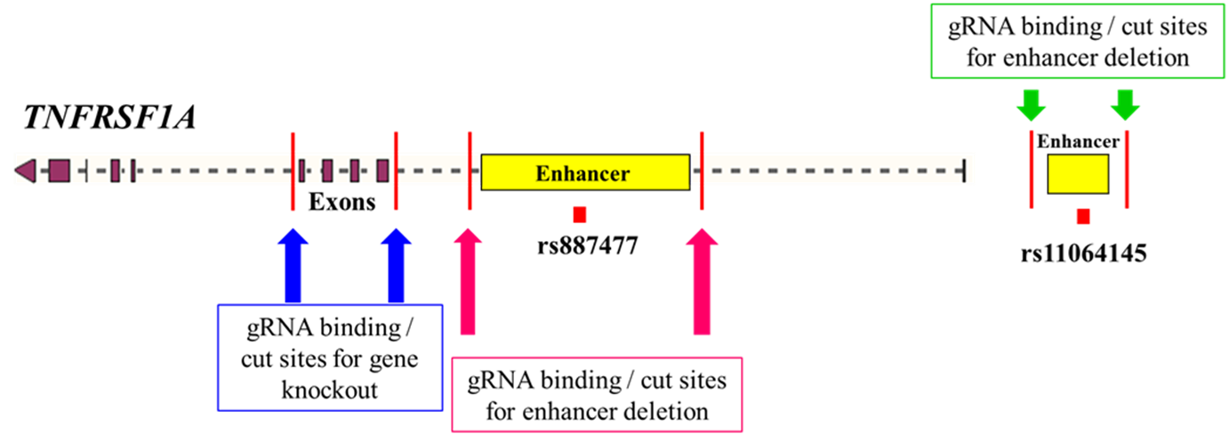
Designing guide RNAs: KO Strategy

Slide 7
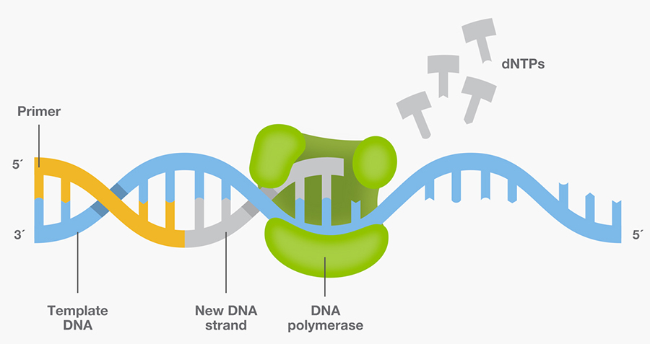


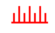
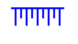

PCR amplification
DNA strand made of nucleotides
Primers (forward and reverse)
Taq DNA polymerase (enzyme)

Slide 9

WHOLE GENOME gene expression
donor
genes
Non-treated, ‘naive’,
monocytes
Notes:
In this dataset we have:
228 donors, ~15000 gene expression values

Slide 10
WHOLE GENOME gene expression
donor
genes
Naive
IFNγ treated
monocytes
Notes:
Gene expression for the monocytes treated by inteferon-gamma – proteins that help regulated the immune system.

Slide 11
WHOLE GENOME gene expression
donor
genes
Naive
IFNγ
Lipopolysaccharide (LPS) treated
monocytes (2 hour wait)
Notes:
Major component of the outer wall of gram negative bacteria, which our body registers as a toxin and elicits a strong immune response.

Slide 12
donor
WHOLE GENOME gene expression
genes
Naive
IFNγ
LPS 2h
Lipopolysaccharides (LPS) treated
monocytes (24 hour wait)
12
Notes:
Also gene expression after 1 day of being treated.

Slide 13
WHOLE GENOME gene expression
donor
genes
Fairfax et al. Innate immune activity conditions the effect of regulatory variants upon monocyte
gene expression. Science, 2014.
Naive
IFNγ
Treatment
LPS 2h
LPS 24h
Notes:
So we have a dataset for 912 samples, gene expression data for ~15,000 genes.

Slide 14
whole genome GENE expression
Notes:
No doubt there is high redundancy amongst the samples, so reducing them from ~15000 to a smaller number could be really helpful into interpreting the dataset (in this case for projecting the gene expression and genes into one value for each sample for each principal component).

Slide 16
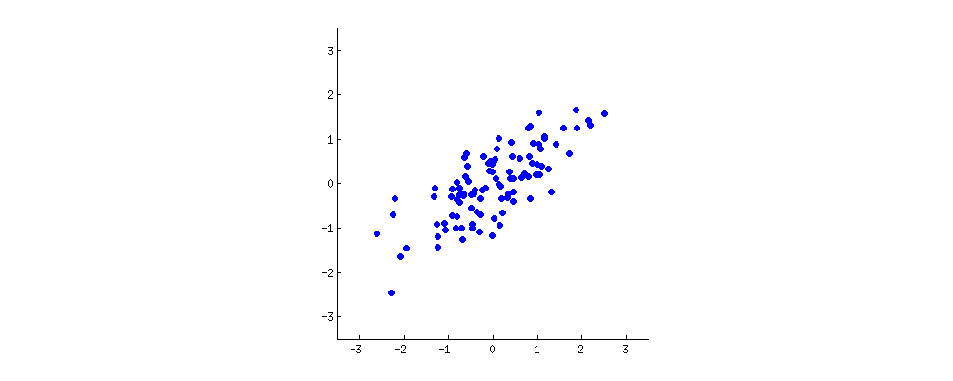
PCA: defining components
https://stats.stackexchange.com/questions/2691/making-sense-of-principal-component-analysis-eigenvectors-eigenvalues
Notes:
Looking at two characteristics of a our dataset (x and y). Want to reduce it from 2D to 1D.
A new property can be constructed by drawing a line through the centre of this cloud and projecting all points onto this line. This new property will be given by a linear combination w1x+w2y, where each line corresponds to some particular values of w1 and w2.

Slide 17
PCA: defining components
https://stats.stackexchange.com/questions/2691/making-sense-of-principal-component-analysis-eigenvectors-eigenvalues
Notes:
PCA will find the "best" line according to two different criteria of what is the "best". First, the variation of values along this line should be maximal. Pay attention to how the "spread" (we call it "variance") of the red dots changes while the line rotates; can you see when it reaches maximum? Second, if we reconstruct the original two characteristics (position of a blue dot) from the new one (position of a red dot), the reconstruction error will be given by the length of the connecting red line. Observe how the length of these red lines changes while the line rotates; can you see when the total length reaches minimum?

Slide 18
PCA on highly correlated data
Notes:
When we have a high correlation, reducing the dimensions makes sense (in this case the PCA component one explains a high percentage of variance of the dataset).

Slide 19
PCA on uncorrelated data
Notes:
However when we have low level of correlation, we are less successful in reducing the dimensions, in this case both components tend to explain the same amount of variance of the dataset.
We rarely would use PCA on a two dimensional dataset, lets look instead a gene expression experiment.

Slide 21
Single Cell Rna sequencing
Notes:
Looking at scRNA-seq from obese mouse tissue. Interesting in difference treatment with clodronate has.

Slide 22
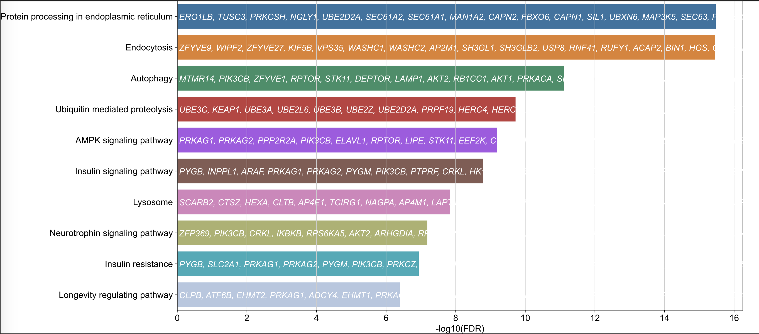
Single Cell Rna sequencing
Notes:
Looking at scRNA-seq from obese mouse tissue. Interesting in difference treatment with clodronate has.

